Slide 1
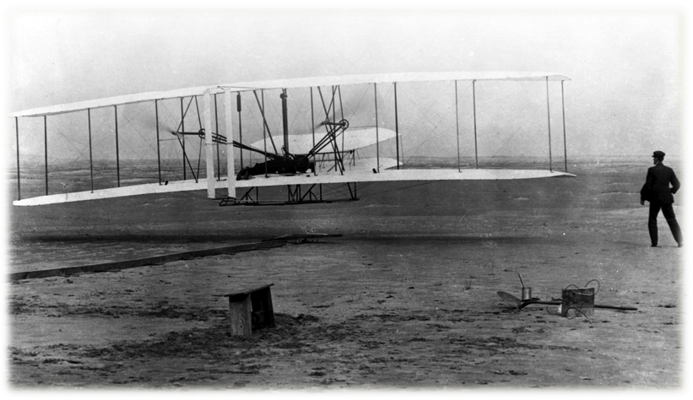
Celebrating air
Notes:
The rush of air that whipped passed their faces was invigorating! It didn’t matter that the temperature was near freezing. Orville was guiding the first controlled flight, and his brother, Wilbur, was running alongside the wing of the flying machine. It was December 17, 1903, and the Wright brothers made a total of four short but historic flights.
Experiencing the success of such a momentous achievement made the practice runs, the hard work, and the criticism of the skeptics pale into insignificance. Apart from the sheer dogged determination of the Wright brothers and the foundational experience of other aviation pioneers such as Otto Lilienthal, without the air and its physical properties providing the “lift,” flight never would have taken place. Lift is a complex physical phenomenon that enables birds and airplanes to fly. Other properties of air allow living creatures to breathe and exist.

Slide 2
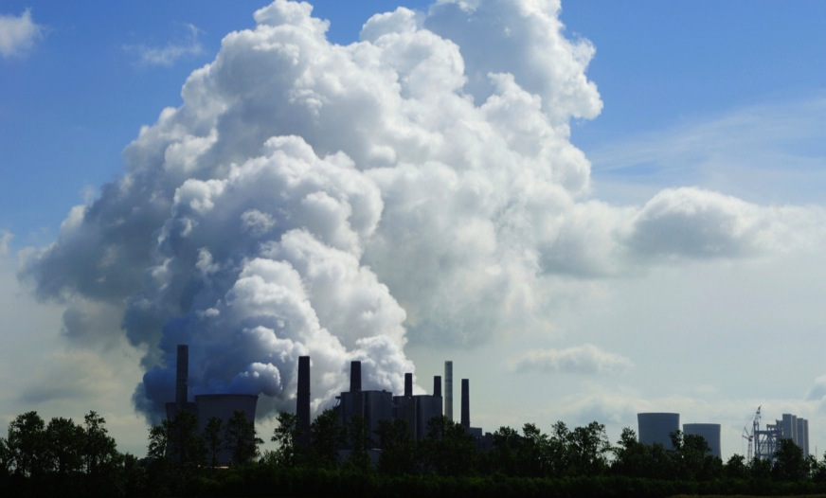
Severe air pollution ensued
Notes:
Those early flight experiences kindle feelings in us of excitement and exhilaration. In contrast, some other events elicit discouragement and despair. Shortly after midnight on December 3, 1984, in the city of Bhopal, India, for example, a poisonous gas cloud escaped from a pesticide factory. The toxic gas covered an area of 30 square miles, immediately killing thousands of people and causing illness for many more. Experts believe that as time went on, many more people eventually perished as a result of this environmental disaster and the severe air pollution that ensued. Clean air is essential and literally constitutes the physical breath of life.

Slide 3
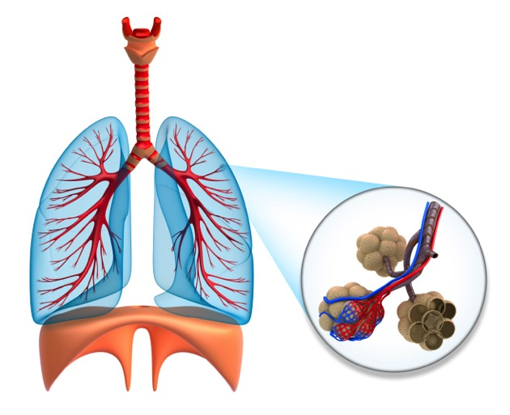
How does it work?
Notes:
Atmospheric air comprises a mixture of gases: 20.98 percent oxygen (O2), 0.04 percent carbon dioxide (CO2), 78.06 percent nitrogen (N2), and 0.92 percent inert (inactive) constituents such as argon and helium. Oxygen is the vital component of air that sustains life. Breathing is the process that moves the air in and out of the lungs and continues the cycle of taking in oxygen and releasing carbon dioxide. This process takes in and exchanges approximately 20,000 liters (5,283 gallons) of air daily. The body carries approximately 1.89 liters (2 quarts) of oxygen in the lungs, blood, and other tissues at any given time.

Slide 4
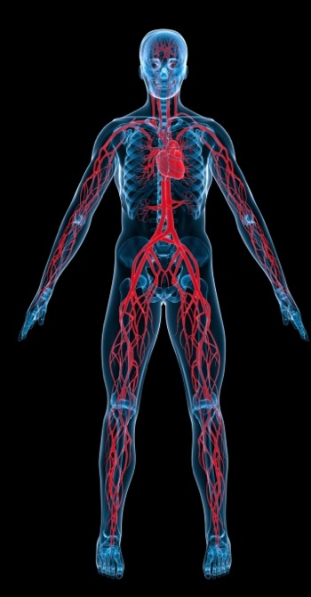
Once oxygen enters
the lungs, it goes into the bloodstream
by a process called
diffusion.
Notes:
Once oxygen enters the lungs, it goes into the bloodstream by a process called diffusion. The heart and circulatory system then pump the blood to every tissue of the body, delivering life-giving oxygen to the tissues and cells. Oxygen promotes efficient cell function by facilitating the metabolism of nutrients and the transfer of energy within the cells.

Slide 5
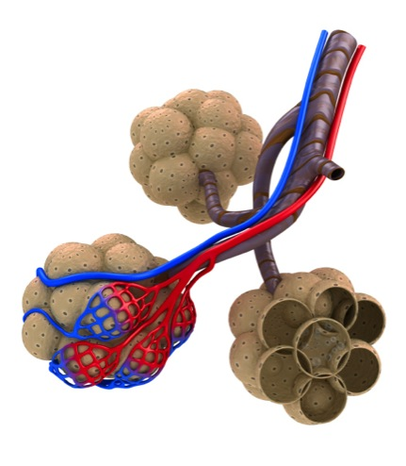
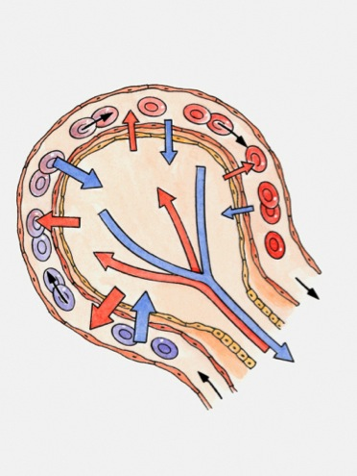
Alveoli
Notes:
The exchange of gases in the lungs occurs across a thin wall approximately two cells thick. These cells line the tiny air sacs of the lungs (alveoli) and also the small blood vessels (capillaries), which carry the oxygen-rich blood to the rest of the body. The waste carbon dioxide is released into the air sacs and expelled from the lungs. The oxygen is carried by millions of red blood cells, which nourish all the body tissues and cells. The exchange of oxygen and carbon dioxide is accomplished within milliseconds, and it takes about only one minute for the newly acquired oxygen to circulate through the body! The lungs are wonderfully designed in order to reach this efficiency and contain more than 600 million of these alveoli (air sacs).

Slide 6
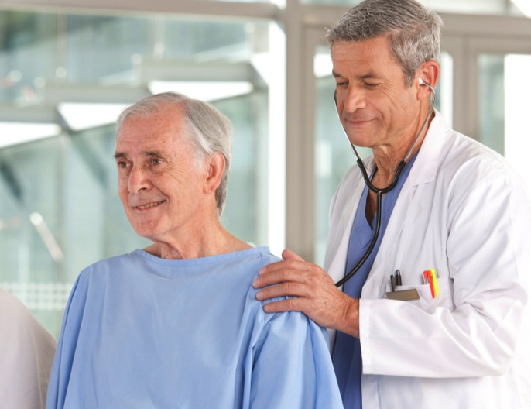
A matter of life and breath
Notes:
The body ensures normal oxygen levels (saturation) by driving the respiration (breathing rate) from a part of the brain called the medulla oblongata in the brain stem. These specialized brain centers automatically regulate the rate and depth of breathing according to the needs of the body while carbon dioxide levels play a very important role in stimulating breathing. It is for this reason that it’s not possible for a healthy person to voluntarily stop breathing for prolonged, indefinite time periods. If one does not inhale fresh air, the level of carbon dioxide builds up in the blood, resulting in the feeling of tremendous “air hunger” forcing one to breathe. This miraculous, irrepressible reflex is life-saving; if breathing stops, the body’s oxygen levels drop dangerously low within minutes, leading to permanent brain damage, followed by death. Brain cells begin to die within four minutes of oxygen deprivation. This fact emphasizes the accuracy of the American Lung Association’s motto, “It’s a matter of life and breath.” We need oxygen for life, and pure fresh air for health.

Slide 7
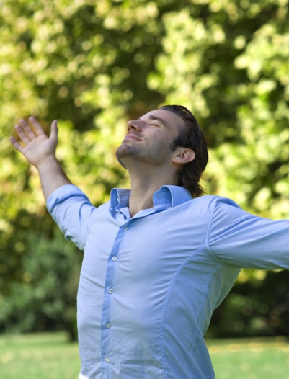
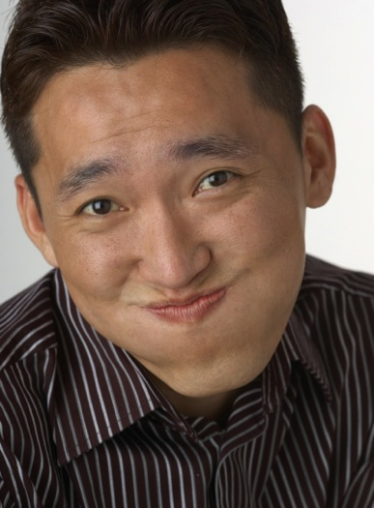
How does exercise change our bodies?
Notes:
During exercise, the increased cellular activity of the muscles produces more carbon dioxide. The carbon dioxide acts on specialized receptors and the respiration center in the brain, causing a higher rate of respiration, which is also deeper. During rest, the breathing rate is lower because the carbon dioxide production is lower. Control mechanisms, however, ensure adequate breathing to provide appropriate amounts of oxygen to all body cells. In addition to removing carbon dioxide from the body, breathing results in a loss of water from the body in the form of water vapor. This is one of the forms of “invisible” water loss, so named because it is not seen or obvious. Prolonged, rapid, deep breathing can aggravate dehydration; this may occur in prolonged exercise, heat exhaustion, and disease states.

Slide 8

Don’t skimp on quality!
Notes:
High-quality fresh air is pure and clean. The life-giving oxygen molecules should be unpolluted. Deep breathing of fresh air imparts an improved sense of well-being. It increases the rate and quality of growth in plants and animals. It improves the function of the lung’s protective cilia. These are the microscopic, fine, hair-like structures that help to keep dust and fine particles as well as irritants from entering the lungs. Good oxygenation lowers the body temperature and resting heart rate, and decreases the survival of certain bacteria and viruses found in the air.

Slide 9

Good quality air can be found in abundance in natural outdoor environments
Notes:
Fresh air is often destroyed and polluted. This can occur through inadequate ventilation of dwellings, especially where open cooking fires and stoves are used. In cities the air in buildings is often recirculated through air-conditioning systems, increasing the pollution from city smog, tobacco smoke, and industrial and other pollutants. On the other hand, good quality air usually can be found in abundance in natural outdoor environments, especially around trees (sometimes called the “lungs of the earth”); green plants; mountains and forests; lakes, oceans, rivers, and waterfalls; and after rainfall. It’s estimated that the algae in the ocean provide almost 90 percent of the oxygen in our atmosphere, with the rest coming from land plants.

Slide 10

How exhilarated you feel!
Notes:
Fresh air, when unpolluted, is invigorating! Notice how exhilarated you feel near a waterfall or at the ocean. This may be one of the reasons for the popularity of holiday resorts and vacation areas in the mountain areas and at the seaside.

Slide 11

Protecting our interests
Notes:
The air also has many protective qualities. On a global level the air and its suspended water vapor protect the earth and its inhabitants from solar radiation and the cold vacuum of outer space. The air recycles water and many chemicals to moderate the climate. Within this atmospheric envelope, life is found over a very wide range of altitudes and temperatures. Some life-forms require large amounts of oxygen; others only a scant amount. Humans need to have optimal health, and fresh, clean air.

Slide 12
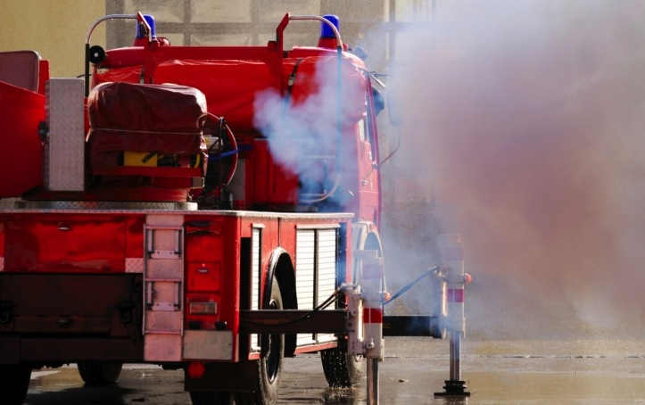
Air pollution
Notes:
Polluted air is found on freeways, at airports, and in closed, poorly ventilated areas. Polluted, smoke-filled air can be associated with increased anxiety, migraine headaches, nausea, vomiting, eye problems, irritability, and respiratory congestion. The World Health Organization (WHO) estimates that more than 2 million people die every year from inhaling tiny pollutant particles present in indoor and outdoor air pollution. These tiny particles, called PM-10 particles (10 micrometers or less), can penetrate the lungs and may enter the bloodstream causing heart disease, lung cancer, asthma, and acute lower respiratory infections.¹ Some 6 million people, mostly children, die each year from acute respiratory infections, complicated particularly by indoor pollution often originating from unvented or poorly vented cooking facilities. In many cities the PM-10 particle level is 15 times above the recommended safety guidelines. The evidence that air pollution results in increased strokes and vascular disease including heart attacks is growing. Additionally, researcher Jennifer Weuve and colleagues have shown that long-term exposure to air pollution speeds up cognitive decline in older women and may increase the progression to dementia.²³⁴

Slide 13
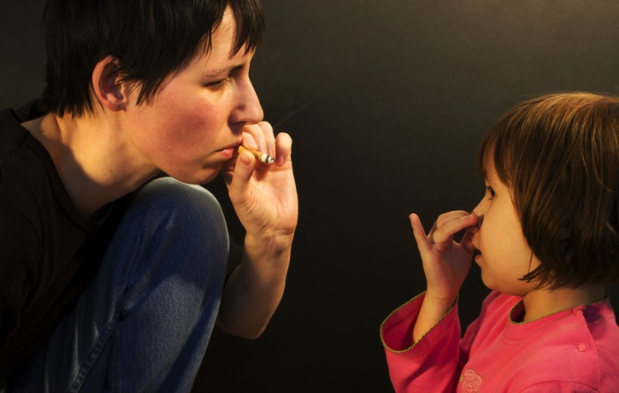
Secondhand smoke
Notes:
The results of pollution described above are sometimes beyond the control of the individual. This is often the case for the “passive smoker,” one who is exposed to secondhand tobacco smoke. Children frequently are victims of secondhand smoke (SHS) in homes where parents and other family members smoke. These children have an increased risk of suffering lower respiratory tract infections and middle ear infections.⁵ The severity and number of asthma episodes in asthmatic children are increased by exposure to SHS. There also is evidence linking tobacco smoke pollution to increased Sudden Infant Death Syndrome (SIDS).⁶ Adults exposed to SHS have an increased risk of lung cancer estimated at 20 percent in women and 30 percent in men who live with a smoker.⁷ Smoke pollution in the workplace increases the risk of nonsmokers developing lung cancer by 16 to 19 percent.

Slide 14

What to do?
Take deep breaths
Exercise regularly
Notes:
What can we do to ensure that we get adequate amounts of clean air and vital oxygen? Avoid tobacco smoke, and, as much as possible, stay out of polluted environments. Avoid shallow breathing; take deep breaths and exercise regularly. This helps us to take full advantage of the natural lung capacity and prevents the lower parts of the lung being under-ventilated. Take intentional breaks during work time to breathe deeply—outdoors, if possible. Good posture and diaphragmatic breathing also are helpful in obtaining optimal respiration, ventilation, and blood flow through the lungs.

Slide 15
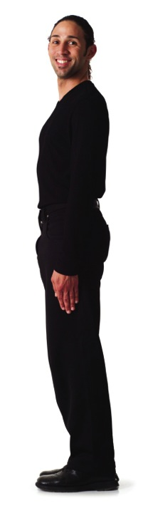
Good posture:
Flatten the plane of the pelvis by contracting the large gluteus muscles.
Stand tall, thus decreasing the forward and backward curves of the spine.
Notes:
Good posture: The late Dr. Mervyn Hardinge, dean emeritus of Loma Linda University School of Public Health, suggested these five steps to help individuals acquire good posture habits:
Flatten the plane of the pelvis by contracting the large gluteus muscles.
Stand tall, thus decreasing the forward and backward curves of the spine.

Slide 16
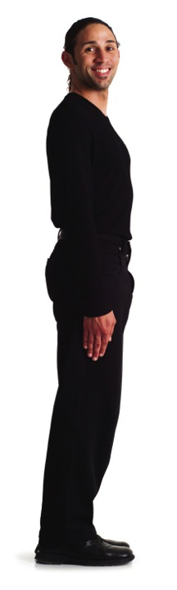
Keep the head back, chin horizontal, and eyes looking straight ahead.
The feet should be slightly apart and directed forward, the upper limbs hanging naturally by the side.
Notes:
Keep the head back, chin horizontal, and eyes looking straight ahead.
The feet should be slightly apart and directed forward, the upper limbs hanging naturally by the side.

Slide 17
Exercise so as to stretch and strengthen muscles.
Notes:
Exercise so as to stretch and strengthen muscles.
Constriction of the thoracic cage by poor posture or even states of disease, often results in diminished lung volume and respiratory reserve. Good posture enhances one’s respiratory capacities and exercise capabilities.

Slide 18

Diaphragmatic breathing
While standing, stretch your arms high above your head.
Breathe in slowly, mouth closed. Normally the lower ribs will expand.
Notes:
Diaphragmatic breathing: People who are fit and exercise regularly also strengthen the muscles of respiration, of which the diaphragm is the most important. To practice diaphragmatic breathing do the following:
While standing, stretch your arms high above your head.
Breathe in slowly, mouth closed. Normally the lower ribs will expand.

Slide 19

Expand the chest as far as possible while breathing in.
At the height of inspiration, take one more whiff of air.
Notes:
Expand the chest as far as possible while breathing in.
At the height of inspiration, take one more whiff of air.

Slide 20

With mouth open let all the air out while slowly bending over.
Cough to get the last bit of air out.
Repeat five to ten times every morning.
Notes:
With mouth open let all the air out while slowly bending over.
Cough to get the last bit of air out.
Repeat five to ten times every morning.

Slide 21
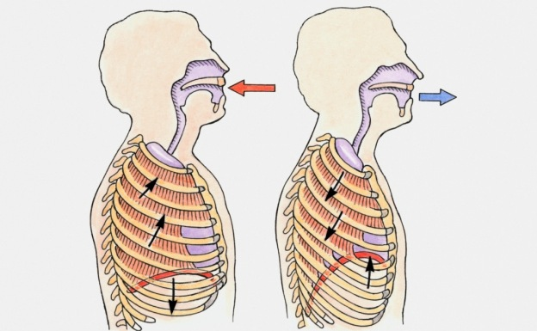
Diaphragm movement
Notes:
Diaphragmatic breathing aerates the respiratory tract and reduces the risk of infection. Quiet breathing moves about 500 cubic centimeters of air in and out of the lungs, whereas the total volume that can pass in and out of the lungs in one breath—the vital capacity—is about 4,000 cubic centimeters, eight times greater than during quiet breathing.
The cells most sensitive to lack of oxygen are those of the brain. The brain is the seat of judgment, reason, intellect, and the will—the control center of our entire being. It’s essential to ensure optimal oxygenation of the brain by avoiding underventilated areas where carbon dioxide, carbon monoxide, and other pollutants may interfere with normal oxygen availability.

Slide 22

In the beginning…
The free, pure air of heaven is one of the richest blessings we can enjoy.
Testimonies, vol. 2, p. 528
Notes:
The atmosphere surrounding the earth provides our wonderfully designed and created bodies with the literal breath of life. Right in the beginning the Lord God our Creator made this provision to support life: “The Lord God formed man of the dust of the ground, and breathed into his nostrils the breath of life; and man became a living being” (Gen. 2:7, NKJV). We have the privilege and responsibility to ensure that our body receives the purest, freshest air possible. We also need to care for the environment and do all we can, individually and collectively, to prevent and minimize air pollution. We cannot do this alone. We need the sustaining power and grace of the loving creator God.

Slide 23

“In the matchless gift of His Son, God has encircled the whole world with an atmosphere of grace as real as the air which circulates around the globe.
All who choose to breathe this life-giving atmosphere will live and grow up to the stature of men and women in Christ Jesus.”⁸
Notes:
“In the matchless gift of His Son, God has encircled the whole world with an atmosphere of grace as real as the air which circulates around the globe. All who choose to breathe this life-giving atmosphere will live and grow up to the stature of men and women in Christ Jesus.”⁸
As we celebrate a vital and fulfilled life, we need to breathe deeply, exercise well, enjoy the beauty of the great outdoors, and never forget the indwelling presence of God, the Breath of Life.

Slide 24

LIFE APPLICATION QUESTIONS
Notes:
LIFE APPLICATION
QUESTIONS

Slide 25

What choices can I make that will help reduce global air pollution?
Does the use of my car, electricity, and other energy sources make a difference?
Notes:
What choices can I make that will help reduce global air pollution?
Does the use of my car, electricity, and other energy sources make a difference?

Slide 26

Do I have access to any forums in which I could participate to advocate for cleaner air, such as the prevention of smoking in public places?
Notes:
Do I have access to any forums in which I could participate to advocate for cleaner air, such as the prevention of smoking in public places?

Slide 27
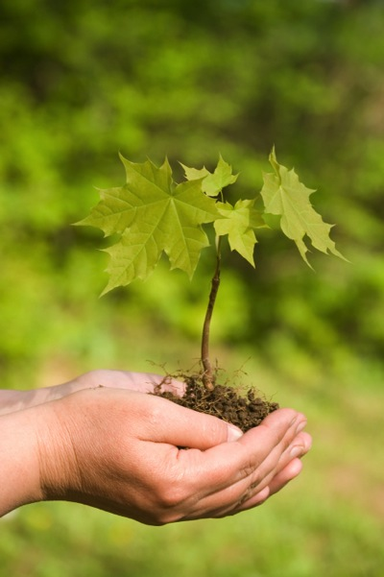
Which trees and shrubs contribute to the cleaning of the air?
Notes:
Which trees and shrubs contribute to the cleaning of the air?

Slide 28
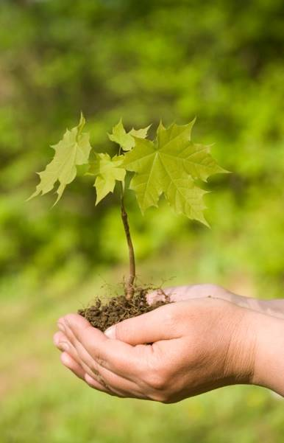
Do I have the option of planting some of these on my own property or in public parks and other community areas?
Notes:
Do I have the option of planting some of these on my own property or in public parks and other community areas?

Slide 29
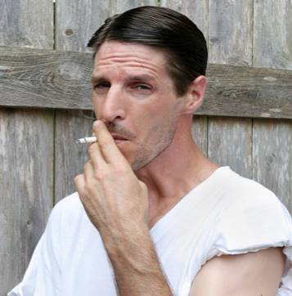
On his way to work each morning, Samuel passes a street corner where day laborers wait for someone to give them employment.
Notes:
On his way to work each morning, Samuel passes a street corner where day laborers wait for someone to give them employment.

Slide 30
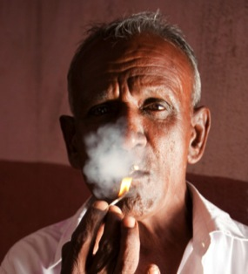
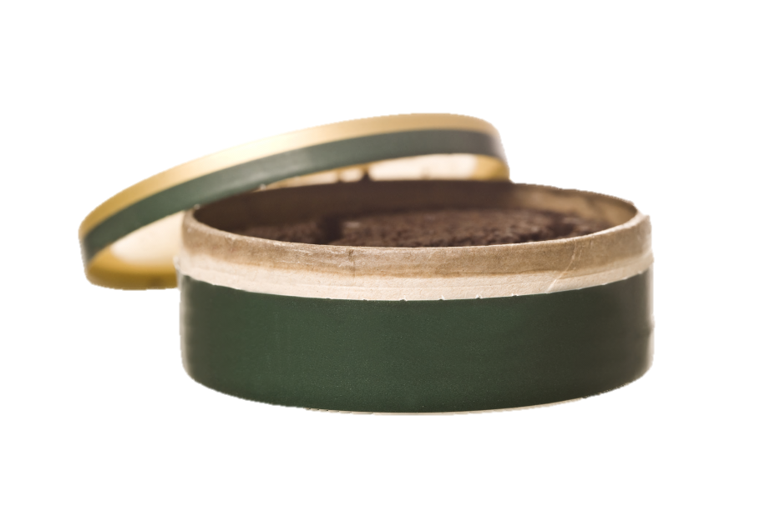
He noticed that most of them smoke or chew tobacco. In what ways could he help them to recognize the health dangers of tobacco?
Notes:
He noticed that most of them smoke or chew tobacco. In what ways could he help them to recognize the health dangers of tobacco?

Slide 31

Would organizing smoking-cessation programs at his church and inviting them to attend be beneficial?
Notes:
Would organizing smoking-cessation programs at his church and inviting them to attend be beneficial?

Slide 32
What effect would distributing brochures or pamphlets on the dangers of smoking have?
Notes:
What effect would distributing brochures or pamphlets on the dangers of smoking have?

Slide 33
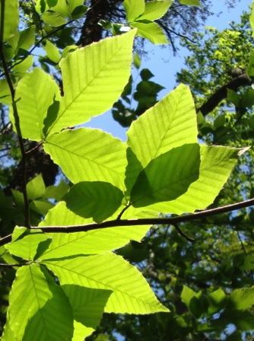
What comes to mind when I consider the wonderful way in which carbon dioxide is continuously removed from the air and oxygen is produced to sustain my life?
Notes:
What comes to mind when I consider the wonderful way in which carbon dioxide is continuously removed from the air and oxygen is produced to sustain my life?

Slide 34

What is my response to my Creator as I consider the finely tuned mechanism that causes me to breathe at the rate and depth that supply me with the sufficient amount of oxygen?
Notes:
What is my response to my Creator as I consider the finely tuned mechanism that causes me to breathe at the rate and depth that supply me with the sufficient amount of oxygen?

Slide 35
How can I praise and thank Him for this wonderful gift, in both words and actions?
Notes:
How can I praise and thank Him for this wonderful gift, in both words and actions?

Slide 36

How can I ensure that I am making full use of the 3,500 cubic centimeters of air space in my lungs that doesn’t get used when I’m doing quiet breathing?
Notes:
How can I ensure that I am making full use of the 3,500 cubic centimeters of air space in my lungs that doesn’t get used when I’m doing quiet breathing?

Slide 37
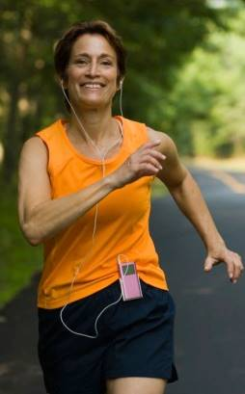
What is “diaphragmatic breathing”?
How can I exercise in a way that forces extra breathing?
Notes:
What is “diaphragmatic breathing”?
How can I exercise in a way that forces extra breathing?

Slide 38
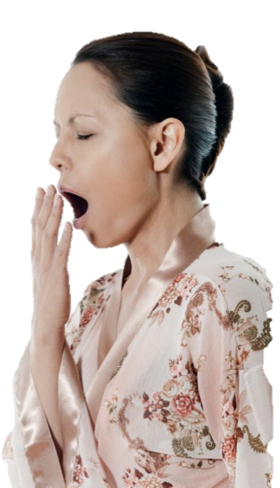
Julia yawns a lot after sitting for a long time. Could it be that she is not breathing well because she’s too sedentary?
Notes:
Julia yawns a lot after sitting for a long time. Could it be that she is not breathing well because she’s too sedentary?

Slide 39
What improvements could be made to her posture while sitting and walking?
How much would one have to move around every half hour to help?
Notes:
What improvements could be made to her posture while sitting and walking?
How much would one have to move around every half hour to help?

